Slide 1

Beverage company Performance Insights
Muhammad Satrio Pamungkas Suharoyo

Slide 2
Table of Content
Company Background, Goals, and List of Provided Data
Beverage Company: Logistic Insights
Beverage Company: Marketing Startegy and Product Development
Beverage Company: Managing Key Vendor
Conclusion and Recommendation

Slide 3
Beverage Company Background
The company (established just 5 years ago), has already experienced rapid growth.
In 2018, its sales reached 5 million dollars.
Offers a unique and diverse range of products that define their distinctive identity.
The management has requested an analysis of the company's performance

Slide 4
Goals
Verifying inventory items completeness
Analyzing company performance to focus on marketing strategies and product development
Identifying non-performing products
Determining key vendors for purchasing and sales logistics

Slide 5
List of provided data
Beginning Inventory : List of inventory status at the beginning of Fiscal Year
Ending Inventory : List of inventory status at the end of Fiscal Year
Purchases : List of purchasing activities throughout the year
Sales : List of sales activities throughout the year

Slide 6
Beverage company LOGISTIC Insights

Slide 7
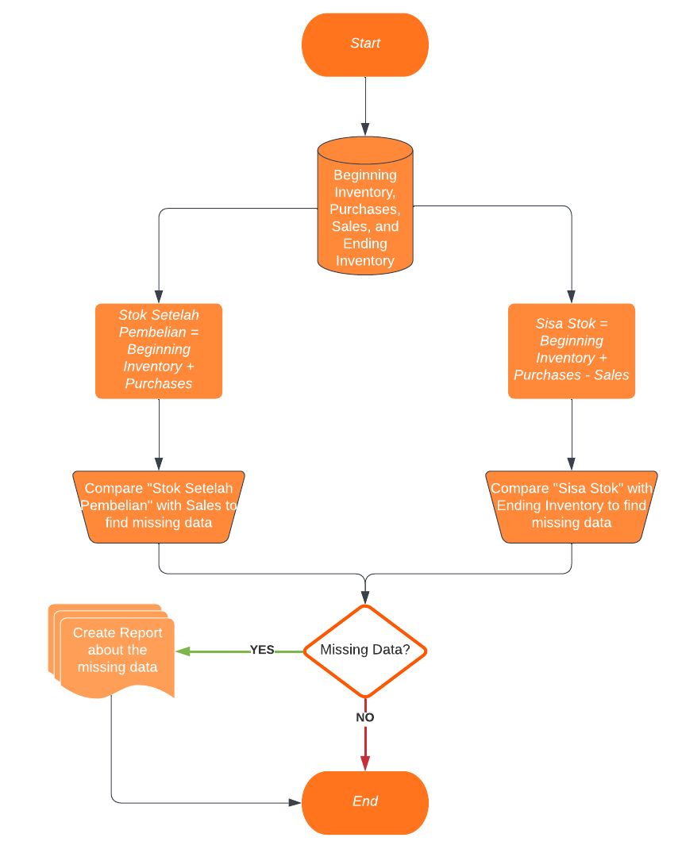
FRAME WORK SQL

Slide 8
Verify inventory items completeness using SQL
Created a new variable called 'stock after purchase' by adding the initial stock with purchase data.
Created another new variable named 'remaining stock' by subtracting the 'stock after purchase' from sales data.
Validated the data by comparing the 'remaining stock' with the end-of-stock data.
After the data has been processed, several errors were found.

Slide 9
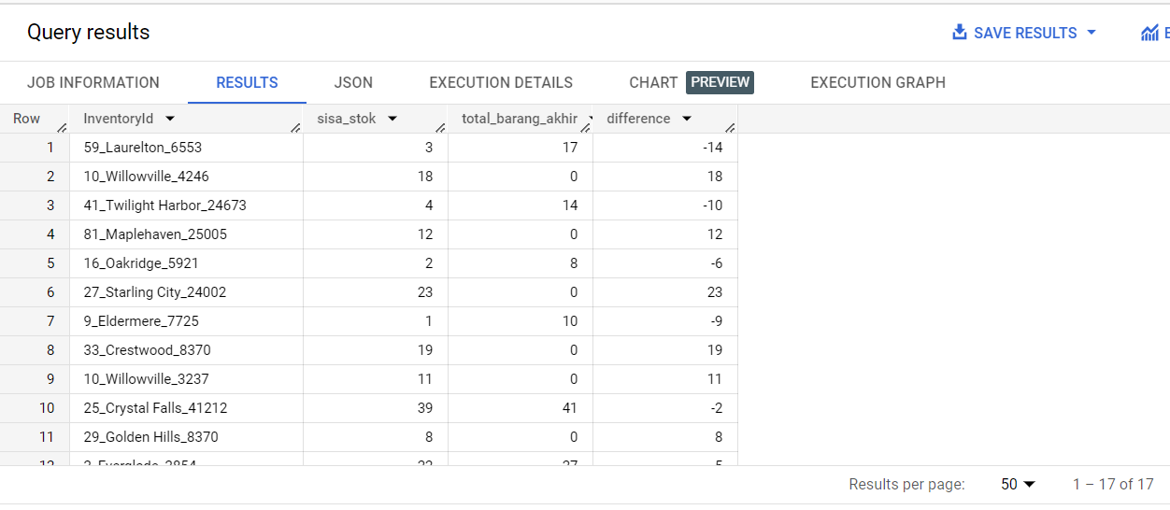
Findings-1
There is a discrepancy between the remaining stock variable (sisa stok) and the ending inventory. There are 17 item types with differing records in both tables.
The data provided by the company at the end of the year (Ending Inventory) should ideally match with My calculation (Beginning Inventory + Purchases - Sales)

Slide 10
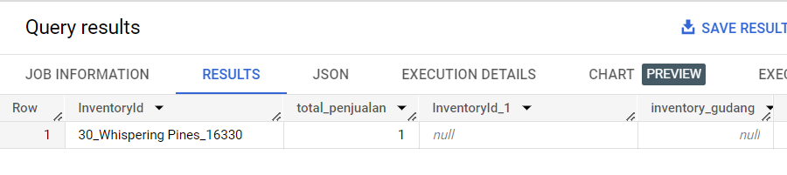
Findings-2
One item type is present in the sales data, but it is missing from the 'stock after purchase' variable (stok setelah pembelian).
This is not ideal in the company's business process. Because it is impossible for any product to be sold if it is not available in the stock warehouse

Slide 11
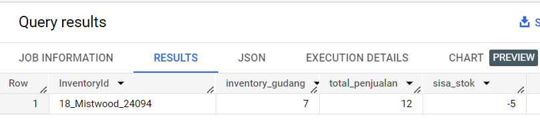
Findings-3
There is one item type with a total sales figure that exceeds the total stock after purchase (stok setelah pembelian).
This is not ideal in the company's business process. Because the total number of items sold should be equal to or less than the items available in the warehouse.

Slide 12
About Findings
There is a discrepancy between the remaining stock variable (sisa stok) and the Ending Inventory record. There are 17 types of items with differing records.
There is 1 type of item present in the Sales data but not in the stock variable after purchase (stok setelah pembelian).
There is 1 type of item with total sales greater than the total stock after purchase (stok setelah pembelian).
It can be concluded that there are still errors in recording the quantity of items.

Slide 13
Beverage company marketing strategy & PRODUC DEVELOPMENT

Slide 14
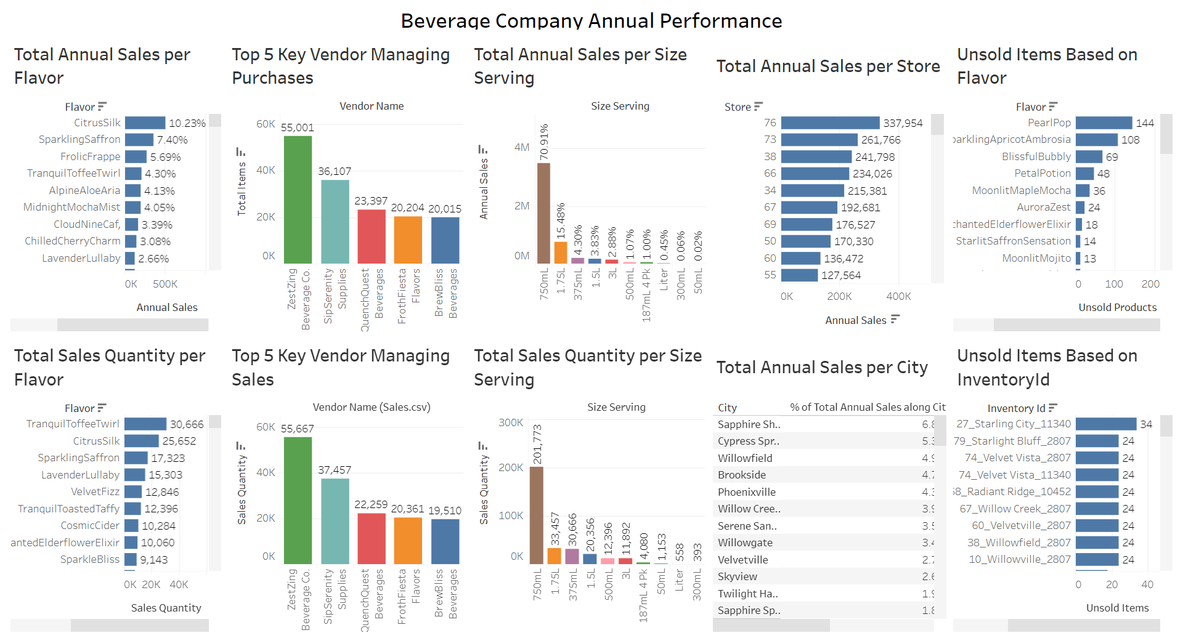

Slide 15
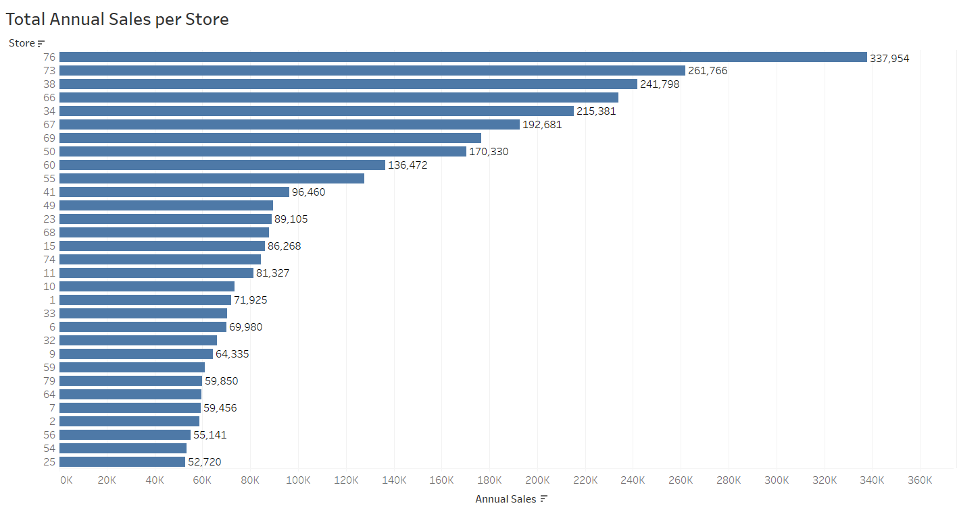
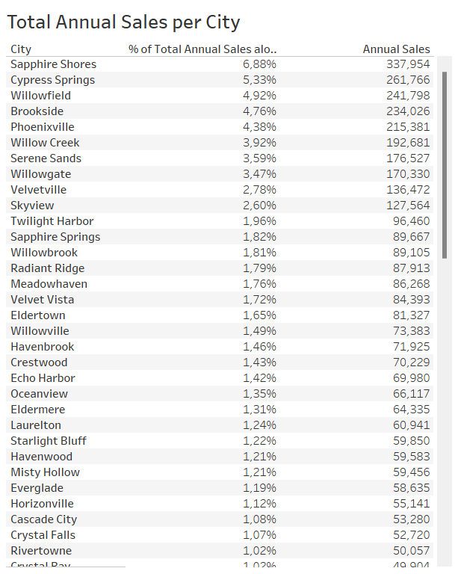
Annual Sales per Store
Stores 76, 73, and 38 make the largest contributions, accounting for 6.8%, 5.3%, and 4.9% of the total annual sales, respectively.
Marketing and supply of goods for the next year can be focused on these three stores.
These stores are located in Sapphire Shores, Cypress Springs, and Willowfield

Slide 16
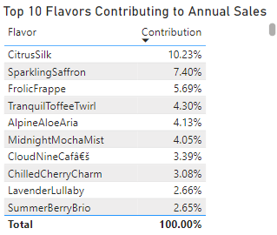
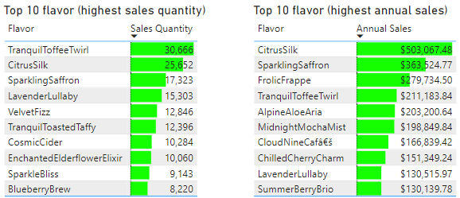
Top 10 flavor (highest sales)
Frolic Frappe is also not the product with the highest quantity of sales. However, it holds the third position as a significant contributor to the company's revenue.
Most of the products that make it into the top 10 as major revenue contributors for the company do not appear in the top 10 in terms of quantity of sales.
Evaluation in the marketing strategy to boost sales for some products such as Frolic Frappe, Tranquill Toffee Twirl, and Alpine Aloe Aria.

Slide 17
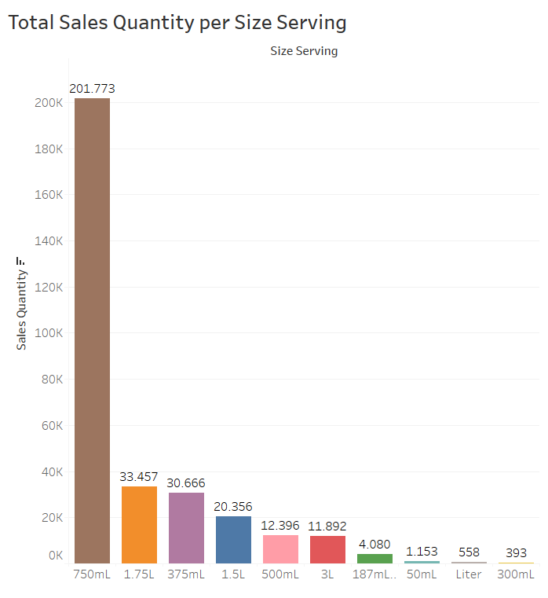
Total Sales per Size Serving
It is clear that the 750ml size is favored, with the highest total purchases among all sizes.
For the 300ml, 1 liter, and 50ml sizes, the continuation of their production needs to be considered.

Slide 18
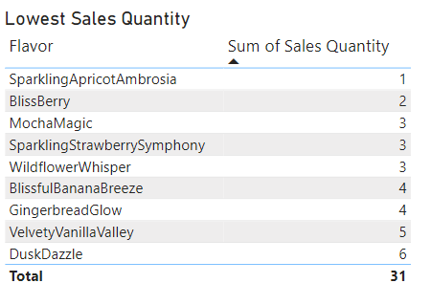
Lowest Sales Quantity
The sustainability of ordering these products needs to be considered.
Need product development, such as flavor modifications.

Slide 19
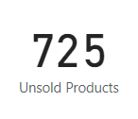
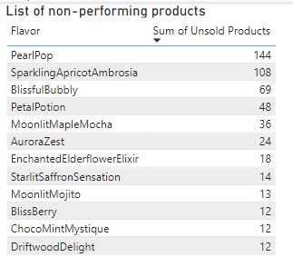
Non-Performing Products
There are 725 unsold items, with Pearl Pop contributing the most.
The continuation of ordering Pearl Pop and Sparkling Apricot Ambrosia needs to be considered.

Slide 20
Beverage company MANAGINg KEY VENDOR

Slide 21
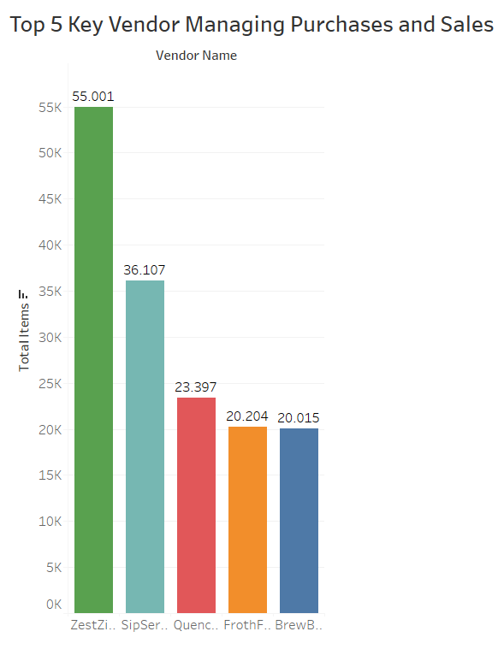
Key Vendors
Selecting the top 5 vendors is essential to enhance future logistics operations, making operations way more effective.
It is expected that company leadership will foster strong relationships with these 5 vendors to ensure smoother business operations.
These five vendors were selected because they are the most frequently utilized vendors by the company

Slide 22
CONCLUSION AND RECOMMENDATION
The inventory item recording is incomplete. There are discrepancies between the calculations I made and the database owned by Beverage Company. There is also data present in the sales data but not in the stock data after purchase. Additionally, there is data with more sales entries than stock data after purchase. If data recording aligns with the Company's business processes, then Ending Inventory should equal Beginning Inventory + Purchases – Sales
Marketing Strategy: Marketing and supply goods for next year can be focused in the stores that are located in Sapphire Shores, Cypress Springs, and Willowfield. Maximizing the sales of Frolic Frappe, Tranquill Toffee Twirl, and Alpine Aloe Aria products. Maximizing sales with 750ml-sized products.
Product Development: For products with low sales, such as Sparkling Apricot Ambrosia and Bliss Berry, flavor modifications are needed. For products sized at 300ml, 1 liter, and 50ml, their production sustainability needs to be considered due to low demand.
For non-performing products, there are 725 unsold items. The least popular flavors are Pearl Pop and Sparkling Apricot Ambrosia. The continuation of ordering Pearl Pop and Sparkling Apricot Ambrosia needs to be considered and also flavor modifications are needed.
The top 5 vendors have been selected as primary suppliers. The selected vendors are ZestZing Beverage Co, SipSerenity Supplies, QuenchQuest Beverages, FrothFiesta Flavors, and BrewBliss Beverage. It is expected that company leadership will foster strong relationships with these 5 vendors to ensure smoother business operations.

Slide 23

THANK YOU

